Slide 1

IS Project Experience (BA)
Mid-term Review
S’eeReal x L’OREAL
Chua Xuan Ni, Rachel | Lee Hui Xin Anne | Ong Qian Ling | Tan Sok Yi | Teng Jing Wen

Slide 2


TABLE OF CONTENTS
01.
PROJECT MANAGEMENT
02.
TECHNICAL DETAILS
03.
PRODUCT DEMO
04.
NEXT STEPS
Introduction, Milestones, Meeting Minutes, Change Management
Architecture, Models, Data Challenges, User Testing
Demonstration of visualisation dashboards
Schedule plans after mid-term
Notes:
*tech first then prod demo

Slide 3


01
PROJECT MANAGEMENT

Slide 4
INTRODUCTION
INTRODUCTION
INTRODUCTION
Deliverables
Sentiment Analysis
Topic Analysis
Rating Analysis
Question(FAQ) Analysis
Analytics dashboard to identify problems and understand customer sentiments to facilitate better decision making
Project Management Technical Details Product Demo Next Steps

Slide 5




TEAM ROLES
INTRODUCTION
INTRODUCTION
Qian Ling
Sok Yi
Rachel
Anne
Jing Wen
Project Manager,
Quality Assurance
Data Engineer
Data Engineer/ Business Analyst
Data Visualisation Specialist
Data Visualisation Specialist
Project Management Technical Details Product Demo Next Steps
Notes:
Q - Do we show the initial proposed roles or the updated one?

Slide 6
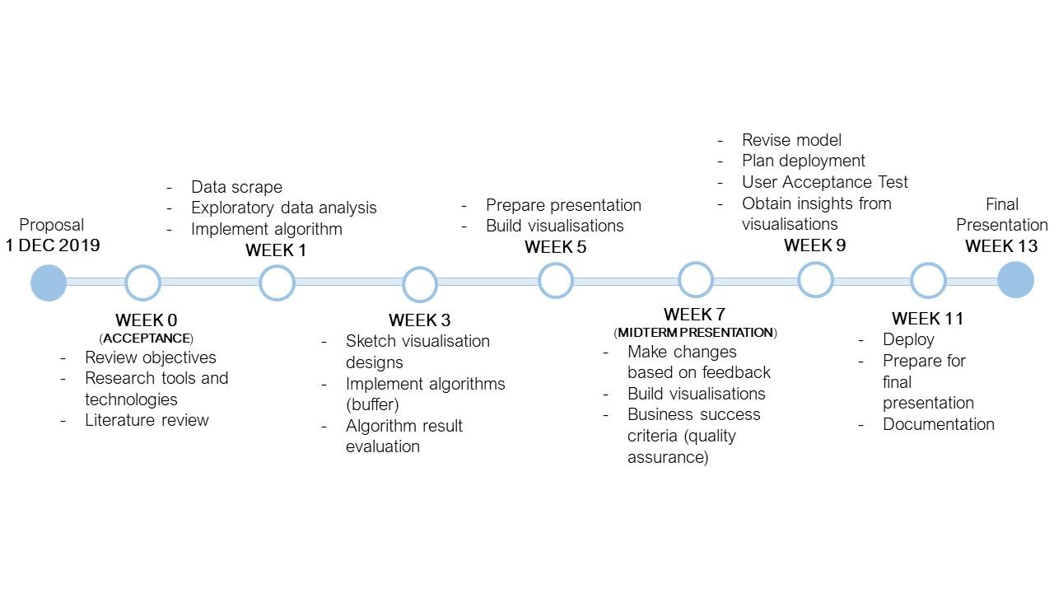
PLANNED MILESTONES
INTRODUCTION
INTRODUCTION
Project Management Technical Details Product Demo Next Steps

Slide 7
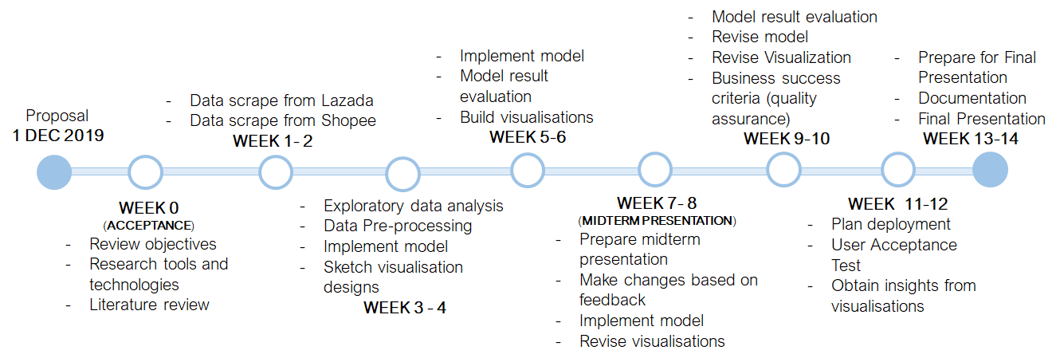
ACTUAL MILESTONES
INTRODUCTION
INTRODUCTION
Project Management Technical Details Product Demo Next Steps
Notes:
Extended time for EDA from 2 weeks to 4 weeks (week 1 to 4)
Week 3-4: Decided to do EDA and UT for Visualization concurrently to better understand the data
Week0 - req gathering

Slide 8

PLANNED VS ACTUAL MILESTONES
INTRODUCTION
INTRODUCTION
Changes/Issues
Planned
Actual
Extended time spent on Data Scraping due to lack of expertise
Data Scrape
Exploratory Data Analysis
Implement Algorithm
WEEK 1
Data Scrape from Lazada
Data Scrape from Shopee
WEEK 1 -2
Planned
Actual
Pushed back EDA due to delay in Data Scraping
Data Scrape
Exploratory Data Analysis
Implement Algorithm
WEEK 1
Exploratory Data Analysis
Data Pre-Processing
Implement Model
Sketch Visualisation Design
WEEK 3 - 4
Extended time for model development
Planned
Actual
Implement Algorithm
WEEKS 1 - 4
Implement Model (and accuracy improvement)
WEEK 3 -7
Project Management Technical Details Product Demo Next Steps

Slide 9

MEETING MINUTES (SPONSOR)
INTRODUCTION
INTRODUCTION
Date | Agenda
20 Jan 2020 (online) | Project progress update Additional requirements (model, visualisation) Fixture of bi-weekly online meetings + other deliverables
29 Jan 2020 (on-site) | Discussion on low-fi visualisation prototype with staff from data and digital e-commerce team Feedback + additional requirements (visualisation)
14 Feb 2020 (online) | User testing on high-fi visualisation prototype Obtain feedback on prototype
Meeting minutes
Project Management Technical Details Product Demo Next Steps

Slide 10
MEETING MINUTES (SUPERVISOR)
INTRODUCTION
INTRODUCTION
Date | Agenda
13 Jan 2020 | Project timeline update Fixture of meetings with project supervisor (Prof. Lo)
31 Jan 2020 | Project progress update (data cleaning and visualisation sketches) Feedback (visualisation, model building, suggested scope)
13 Feb 2020 | Project progress update (data cleaning, visualisation sketches, model building) Feedback (dashboard prototype, model building) Mid-term brief
Meeting minutes
Project Management Technical Details Product Demo Next Steps

Slide 11
CHANGE MANAGEMENT
INTRODUCTION
INTRODUCTION
Change # | Type of change | Description | Impact | Outcome
1 | Additional requirements Competitor Analysis Request by: Sponsor | Replace questions analysis with competitor Analysis: Include sentiment analysis and price comparison Request made by sponsor after conducting online discussion | High | Work on the requirement after mid-term review.
Project Management Technical Details Product Demo Next Steps
Notes:
Communicated with client that will work on comp ana if available capacity

Slide 12
CHANGE MANAGEMENT
INTRODUCTION
INTRODUCTION
Change # | Type of change | Description | Impact | Outcome
2 | Implement changes from User Feedback (UF) 1 Request by: Sponsor | Changes: Analyse response rate vs number of reviews Day/Time matrix analysis (to identify peaks in review posted) Include additional filters Request made by sponsor after conducting UF 1 - improvement on the low fi UI. | Medium | Changes have been applied accordingly and ready for for product demo during mid-term review.
Project Management Technical Details Product Demo Next Steps

Slide 13
CHANGE MANAGEMENT
INTRODUCTION
INTRODUCTION
Change # | Type of change | Description | Impact | Outcome
3 | Implement changes from User Feedback (UF) 2 Request by: Sponsor | Changes: Display monthly % change in positive/negative reviews Realignment of dashboard (including filters) Remove word cloud visualisations Request made by sponsor after conducting UF 2 - improvement on the UI. | Low | Changes have been applied accordingly and ready for for product demo during mid-term review.
Project Management Technical Details Product Demo Next Steps

Slide 14

02
TECHNICAL DETAILS

Slide 15
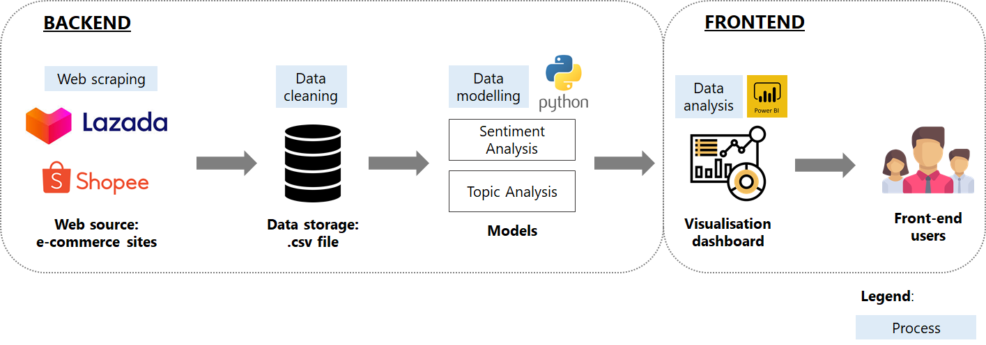
ARCHITECTURE DIAGRAM
INTRODUCTION
INTRODUCTION
Project Management Technical Details Product Demo Next Steps
Notes:
Data source/collection > cleaning > model > viz > end user

Slide 16

02
TECHNICAL DETAILS - BACK END

Slide 17
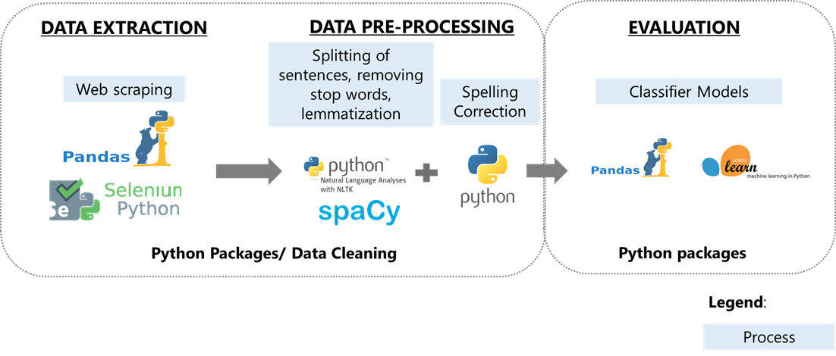
SENTIMENT ANALYSIS
SENTIMENT ANALYSIS
INTRODUCTION
INTRODUCTION
INTRODUCTION
INTRODUCTION
Project Management Technical Details Product Demo Next Steps
Project Management Technical Details Product Demo Next Steps

Slide 18
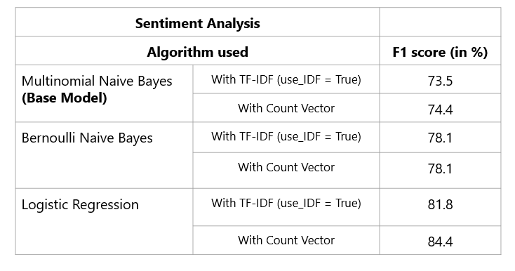
MODEL EVALUATION
INTRODUCTION
INTRODUCTION
Project Management Technical Details Product Demo Next Steps
Notes:
List the models and the outcome (ie fscore)??

Slide 19


CHALLENGES
INTRODUCTION
INTRODUCTION
Handling multiple sentiment in a review
Identify Emoji
Project Management Technical Details Product Demo Next Steps

Slide 20
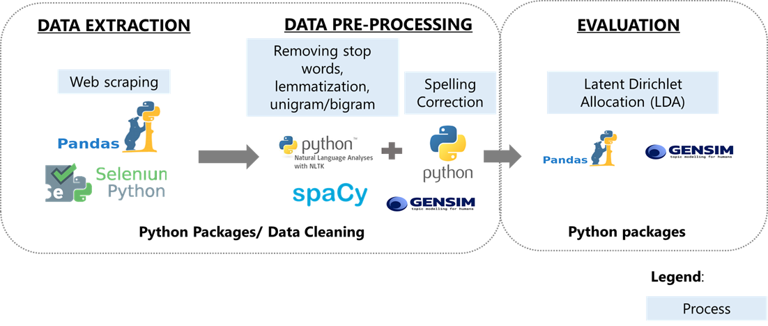
SENTIMENT ANALYSIS
TOPIC ANALYSIS
INTRODUCTION
INTRODUCTION
INTRODUCTION
INTRODUCTION
Project Management Technical Details Product Demo Next Steps

Slide 21
MODEL EVALUATION
INTRODUCTION
INTRODUCTION
Topic Analysis
Algorithm used | Perplexity Score | Coherence Score
Latent Dirichlet Allocation | -6.152 | 0.474
Latent Dirichlet Allocation - Mallet | -6.656 | 0.479
Project Management Technical Details Product Demo Next Steps
Notes:
List the models and the outcome (ie fscore)??

Slide 22
MODEL RESULT
INTRODUCTION
INTRODUCTION
Dataset from Shopee and Lazada
Product
Delivery
Product | Make
Skin | Water
Love | Day
Makeup | Dry
Face | Foundation
Good | Item
Delivery | Hair
Fast | Free
Received | Buy
condition | Time
Project Management Technical Details Product Demo Next Steps
Notes:
List the models and the outcome (ie fscore)??

Slide 23
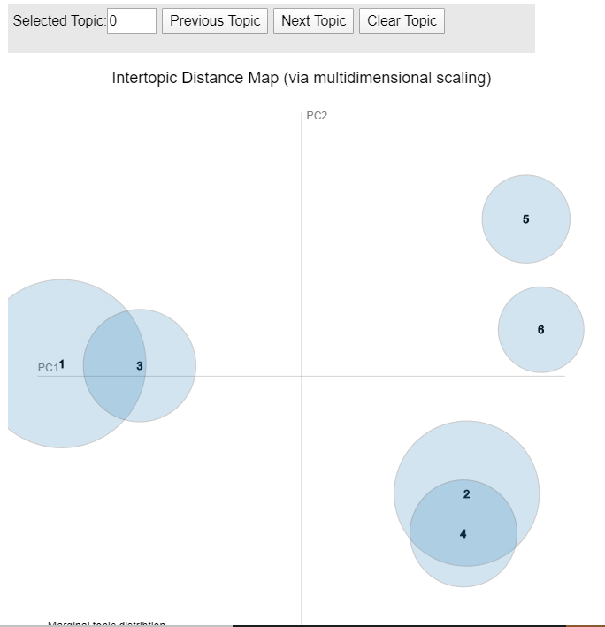

CHALLENGES
INTRODUCTION
INTRODUCTION
Overlapped topics
Difficulty in identifying the topics
Project Management Technical Details Product Demo Next Steps
Notes:
When we do topic analysis on more than 2 topic, we realised that the result gave us topics that are skewed more towards the product category. For e.g. cleansing foam gave reviews like skin become fresh, smooth, whereas lipstick gave reviews more on the colour. That was not what we want we already have the category of the product when we scrape the data. Hence, we decide to limit the topics to 2 where it can give us a more accurate topic classification when we looked at the final result. In order to overcome this challenge, we are currently looking into semi-supervised lda model and also looking into how we can fine tune the parameters to get a better result

Slide 24

03
TECHNICAL DETAILS - FRONT END

Slide 25
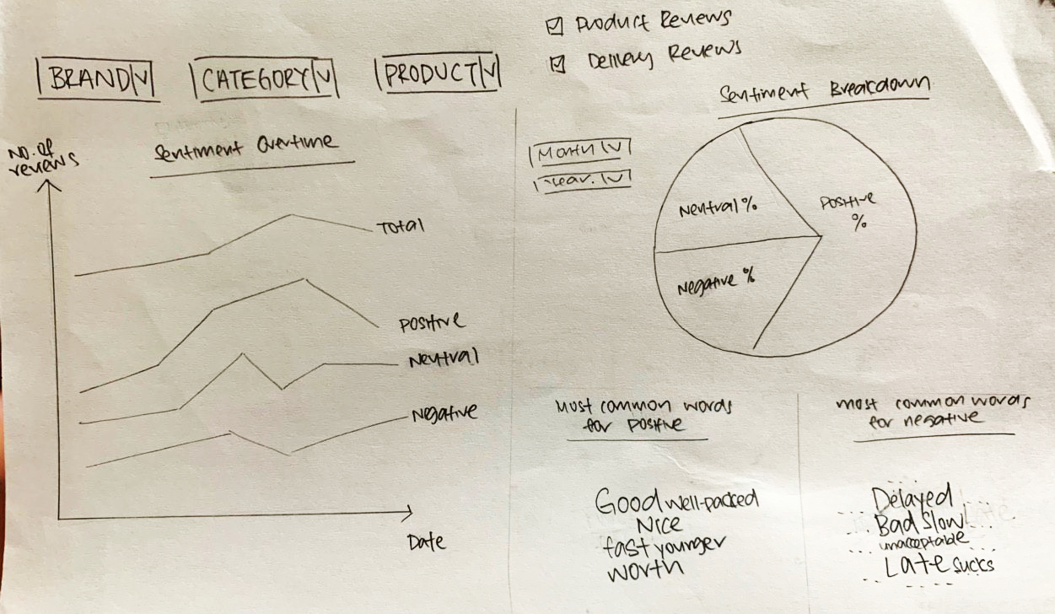
USER FEEDBACK 1
INTRODUCTION
INTRODUCTION
Low Fidelity Dashboard Prototype
Feedback #1:
Include filter for date
Feedback #2: Include for KPIs/business metrics (e.g. response rate,ratings)
Project Management Technical Details Product Demo Next Steps
Notes:
Low fidelity prototype
Good to have impt info to be placed at the start of dashboard. Can include kpis/biz metrics right at the start.

Slide 26
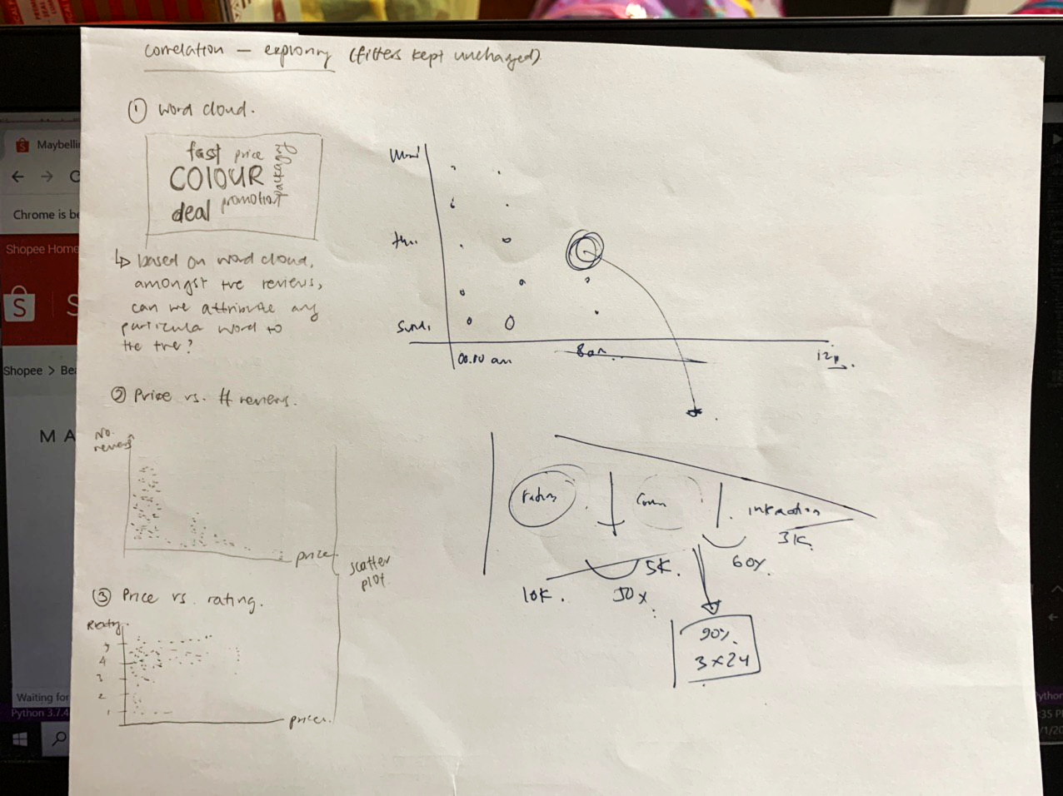
USER FEEDBACK 1
INTRODUCTION
INTRODUCTION
Low Fidelity Dashboard Prototype
Feedback #4:
Identify hourly spikes in review within the week
Feedback #3:
Identify correlation between ratings and sentiments
Feedback #5:
Funnel approach to determine proportion of orders reviewed, and response rate
Project Management Technical Details Product Demo Next Steps
Notes:
Low fidelity prototype

Slide 27
USER FEEDBACK 1
INTRODUCTION
INTRODUCTION
UF Round | Feedback/Changes | Completion
1 | Include filter for date (by month/year) | Completed
 | Consider more business metrics on dashboard (e.g. response rate) | Completed (added percentage change in reviews, response rate, average ratings)
 | Include graph to identify correlation between ratings and sentiments | Completed
 | Identify hourly spikes in reviews within the week | Completed (not applicable for data on Lazada)
 | Include a funnel to show proportion of reviews vs. responses | Completed
Project Management Technical Details Product Demo Next Steps
Notes:
kiv??

Slide 28
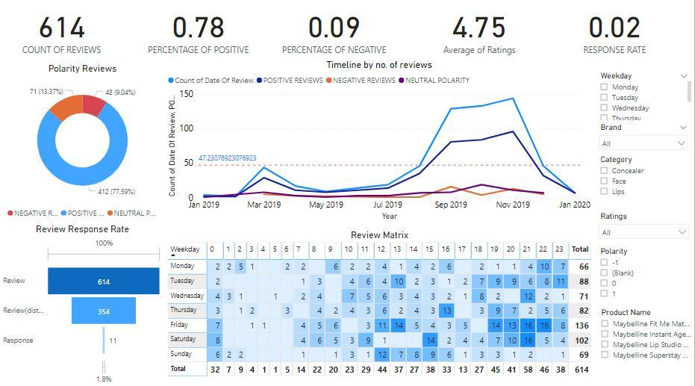
USER FEEDBACK 2
INTRODUCTION
INTRODUCTION
Power BI Dashboard using Prototype data (Page 1)
Feedback #1:
Display it by monthly percentage change
Feedback #2:
Shifted it to a horizontal filter bar
Project Management Technical Details Product Demo Next Steps
Notes:
Highfi proto

Slide 29
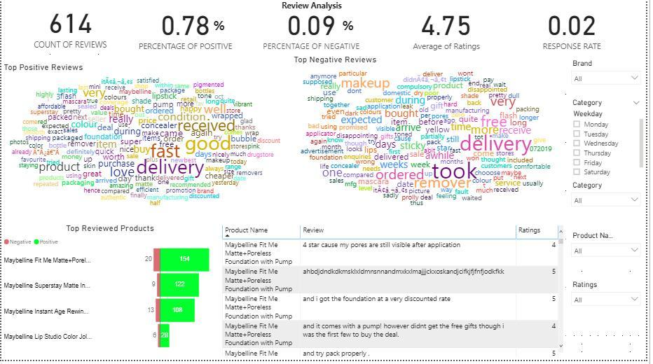
USER FEEDBACK 2
INTRODUCTION
INTRODUCTION
Power BI Dashboard using Prototype data (Page 2)
Feedback #3:
Remove word clouds
Project Management Technical Details Product Demo Next Steps
Notes:
Highfi proto

Slide 30
USER FEEDBACK 2
INTRODUCTION
INTRODUCTION
UF Round | Feedback | Completion
2 | #1: Display monthly percentage change in positive/negative reviews | Completed
 | #2: Realign dashboard layout (change filters to horizontal layout) | Completed
 | #3: Remove word clouds | Completed
Project Management Technical Details Product Demo Next Steps
Notes:
kiv??

Slide 31

03
PRODUCT DEMO

Slide 32
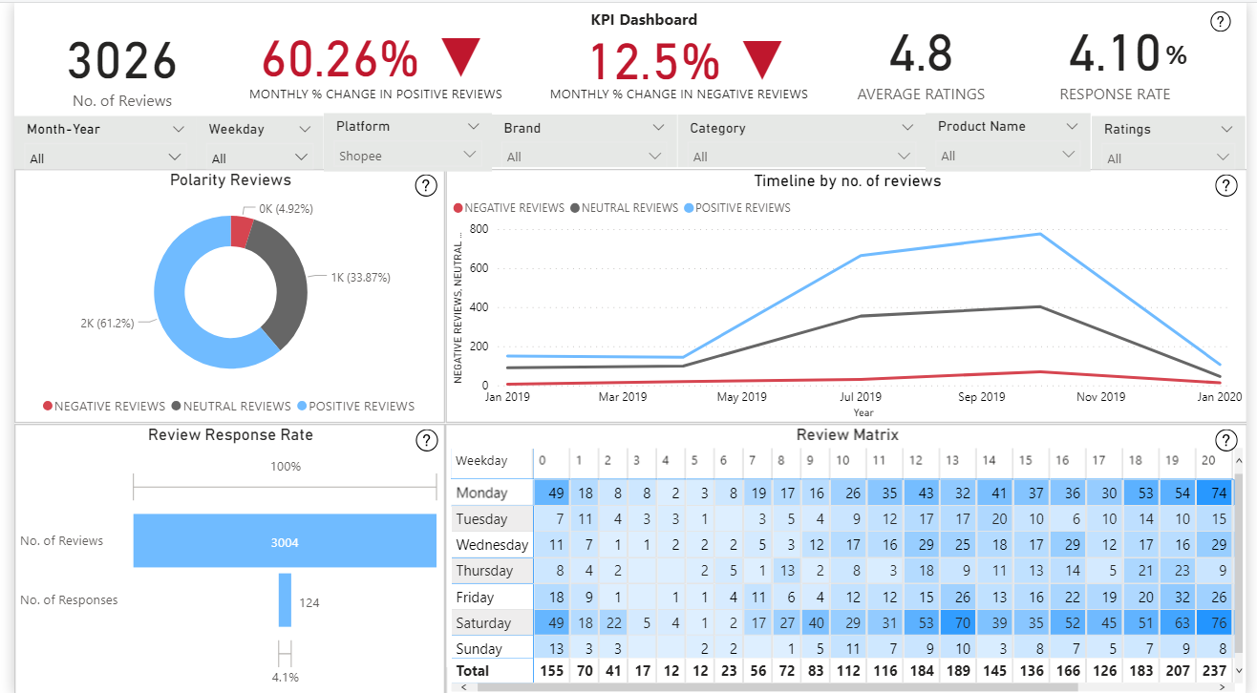

Slide 33
DASHBOARD PAGE 1
INTRODUCTION
INTRODUCTION
Objectives:
Identify the changes in sentiments over the month.
Identify the response rate of L'oreal's customer service team, and determine if this meets the team KPI.
Identify the time period for better manpower allocation and targeted promotions.
Page 1: KPI Dashboard
Project Management Technical Details Product Demo Next Steps

Slide 34
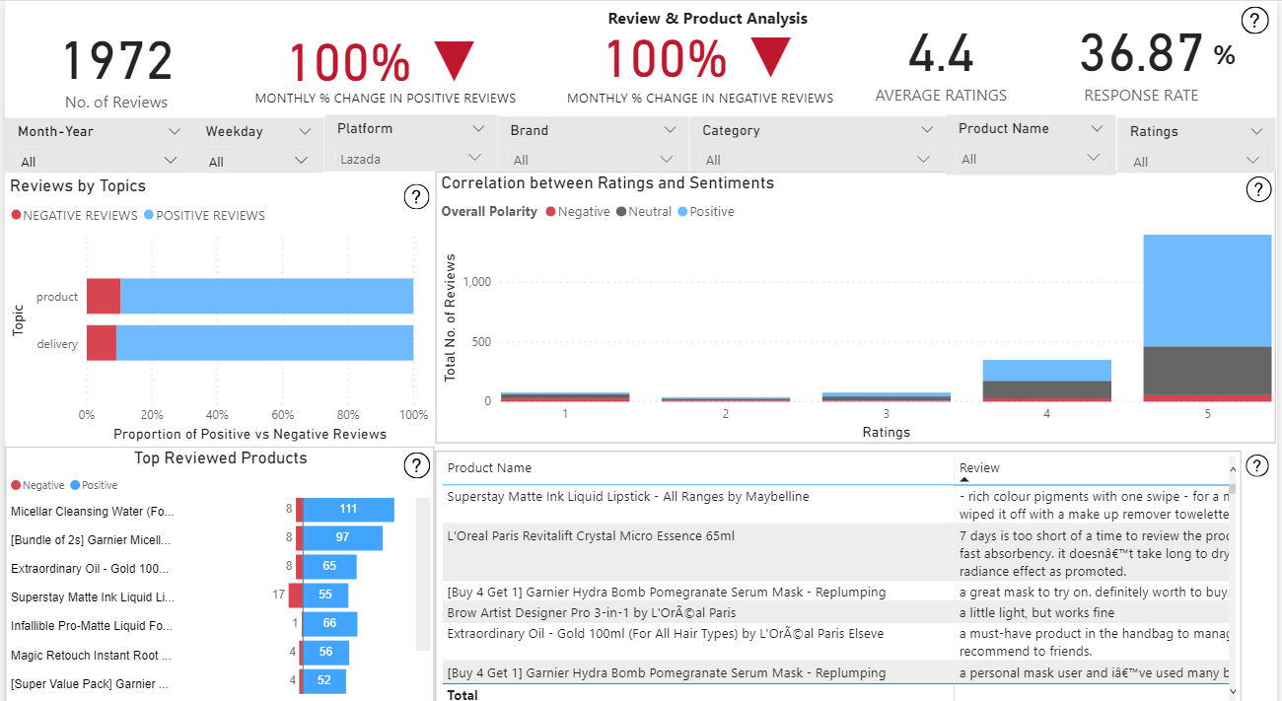

Slide 35
DASHBOARD PAGE 2
INTRODUCTION
INTRODUCTION
Page 2: Review & Product Analysis
Objectives:
Identify what factors affect the customer satisfaction level.
Identify the distribution of ratings relative to the sentiments.
Identify the top reviewed products.
Project Management Technical Details Product Demo Next Steps

Slide 36
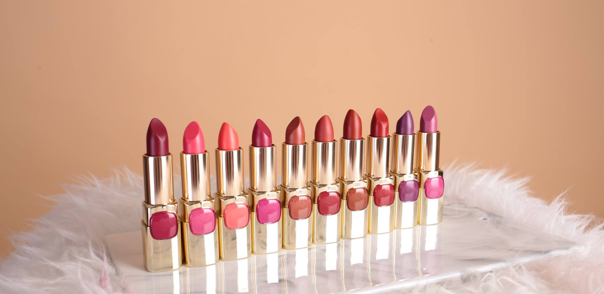

04
NEXT STEPS

Slide 37
NEXT STEPS
INTRODUCTION
INTRODUCTION
Improve model accuracy
Competitor analysis
Rating analysis
Sales analysis
Project Management Technical Details Product Demo Next Steps
Notes:
Week 9-10 : competitor analysis + refine model accuracy

Slide 38

THANK YOU!

